Slide 1

Megaminx
MMR 2020 – Group 3

Slide 2
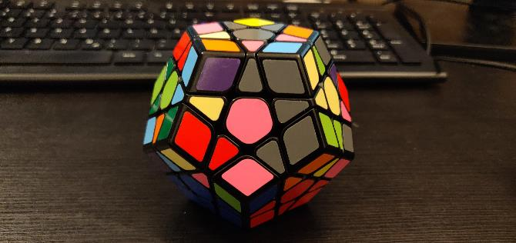
Goals
Reminder: Goal 36

Slide 3
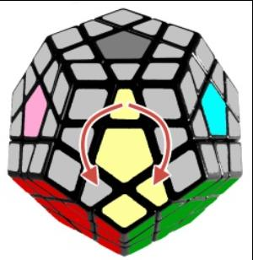
ALGORITHMS
SP3
SP4
F‘ R‘ F‘ F‘ R F
F L F F L‘ F‘

Slide 4
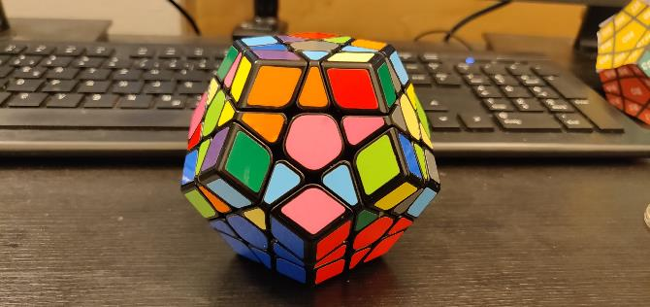
Goals
Goal 37
Moves: r, u, f, l, r_v

Slide 5
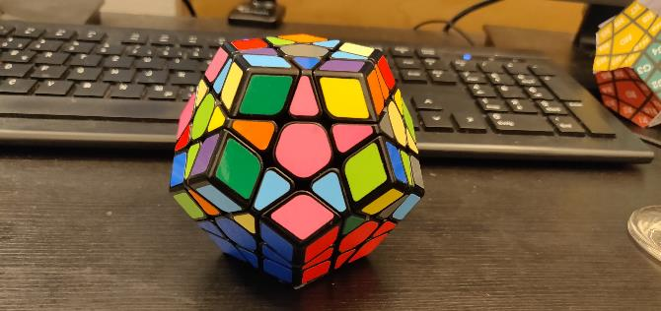
Goals
Goal 38
Moves: r, u, f, l, r_v

Slide 6
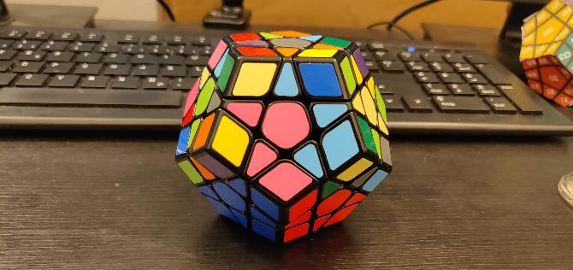
Goals
Goal 39
Moves: SP3

Slide 7
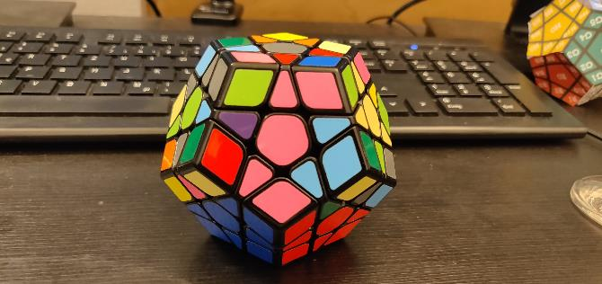
Goals
Goal 40
Moves: r, u, f, l, r_v

Slide 8
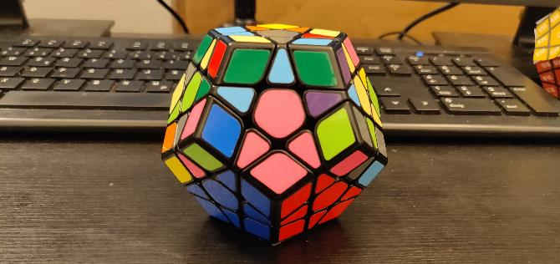
Goals
Goal 41
Moves: SP4

Slide 9
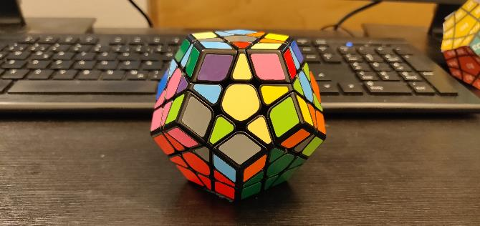
Goals
Goal 42
Moves: r_v

Slide 11
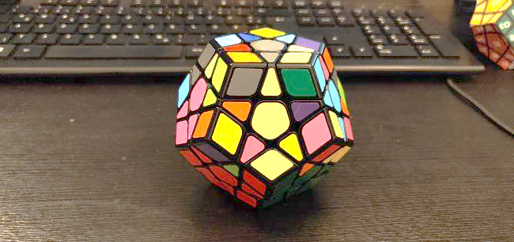
Goals
Goal 43
Moves: r, u, f, l, r_v

Slide 12
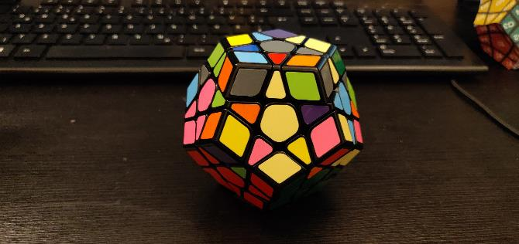
Goals
Goal 45
Moves: r, u, f, l, r_v

Slide 13
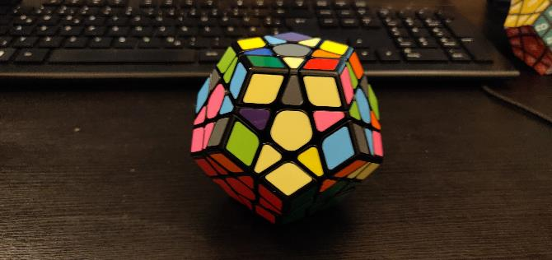
Goals
Goal 46
Moves: SP3

Slide 14
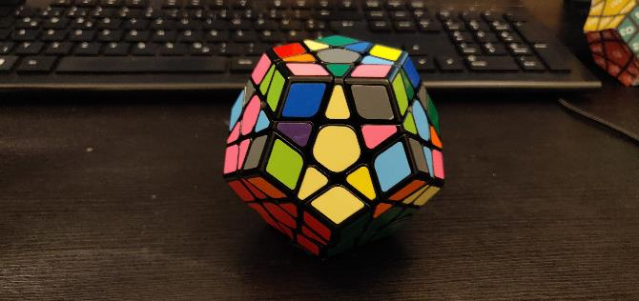
Goals
Goal 47
Moves: r, u, f, l, r_v

Slide 15
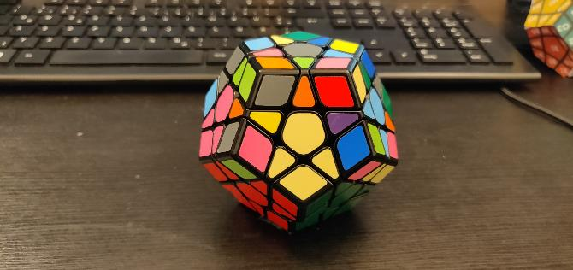
Goals
Goal 48
Moves: SP4

Slide 16
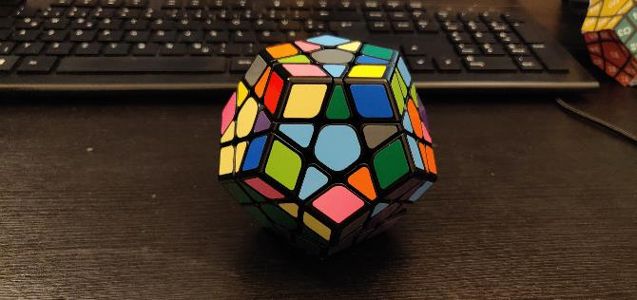
Goals
Goal 49
Moves: r_v

Slide 18
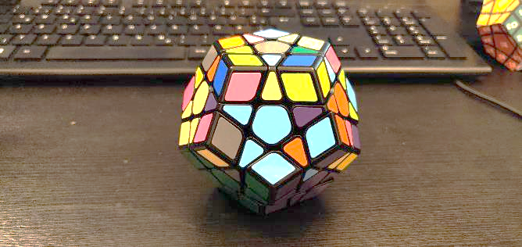
Goals
Goal 50
Moves: r, u, f, l, r_v

Slide 19
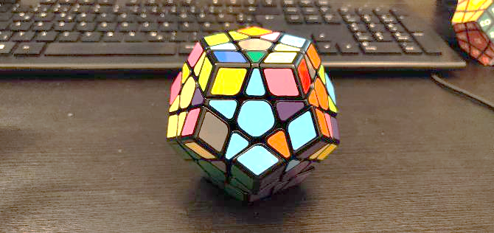
Goals
Goal 51
Moves: r, u, f, l, r_v

Slide 20
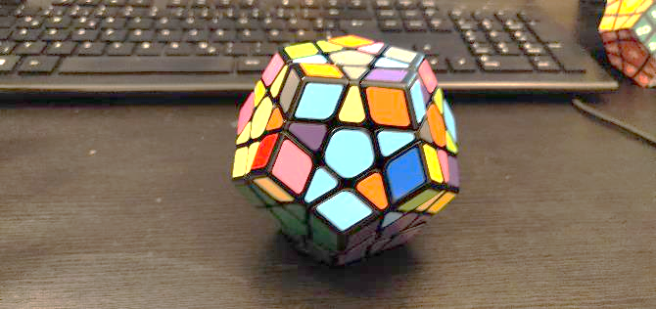
Goals
Goal 52
Moves: SP3

Slide 21
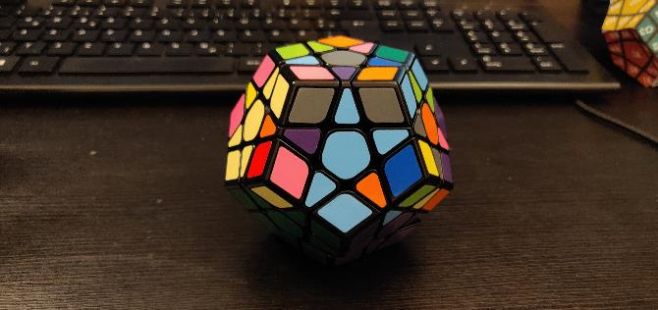
Goals
Goal 53
Moves: r, u, f, l, r_v

Slide 22
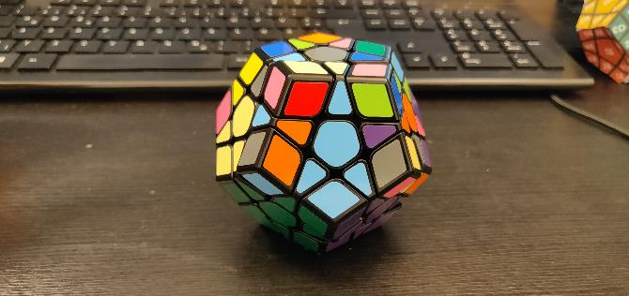
Goals
Goal 54
Moves: SP4

Slide 23
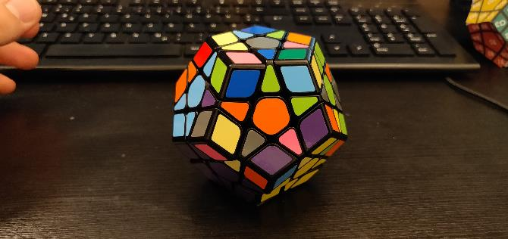
Goals
Goal 55
Moves: r_v

Slide 25
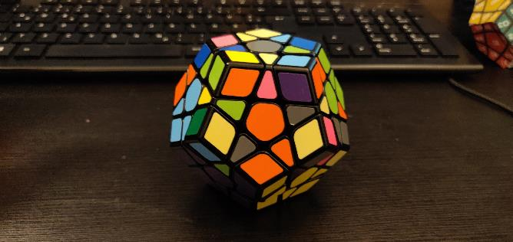
Goals
Goal 56
Moves: r, u, f, l, r_v

Slide 26
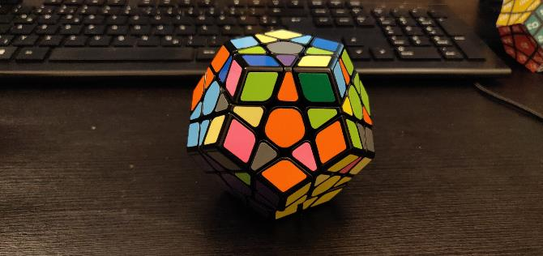
Goals
Goal 57
Moves: r, u, f, l, r_v

Slide 27
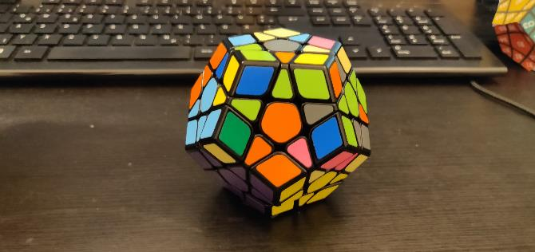
Goals
Goal 58
Moves: SP3

Slide 28
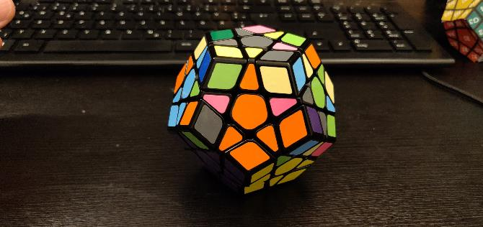
Goals
Goal 59
Moves: r, u, f, l, r_v

Slide 29
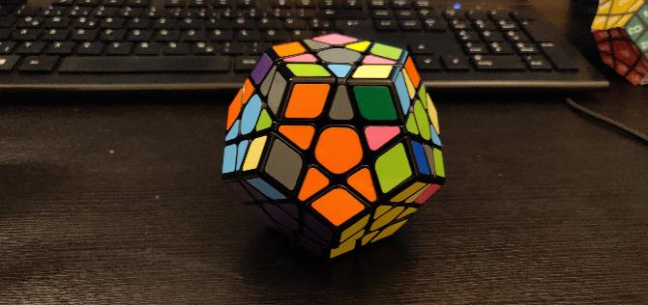
Goals
Goal 60
Moves: SP4

Slide 30
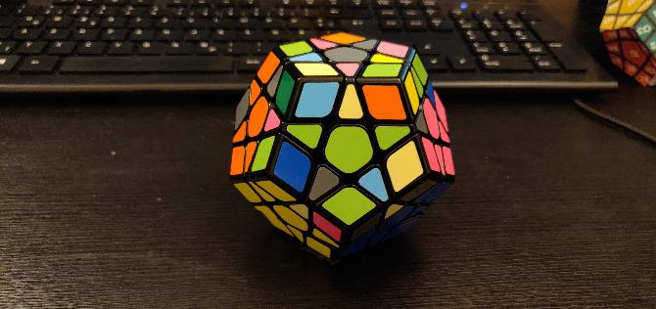
Goals
Goal 61
Moves: r_v

Slide 32
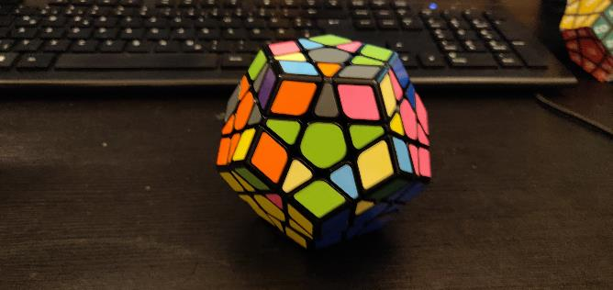
Goals
Goal 68
Moves: r, u, f, l, r_v

Slide 33
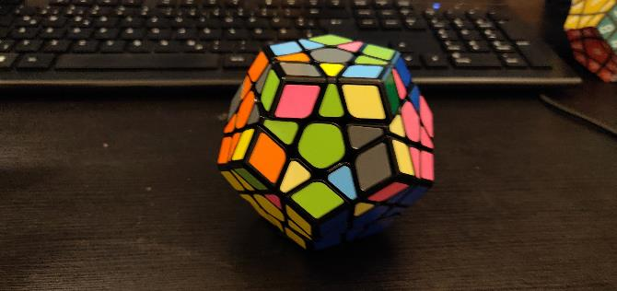
Goals
Goal 69
Moves: r, u, f, l, r_v

Slide 34
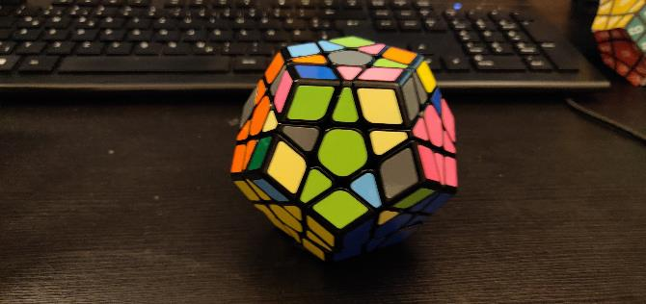
Goals
Goal 70
Moves: SP3

Slide 35
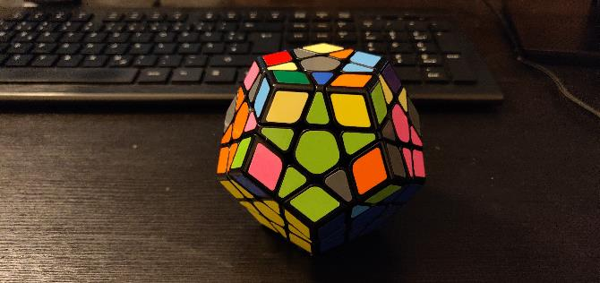
Goals
Goal 71
Moves: r, u, f, l, r_v

Slide 36
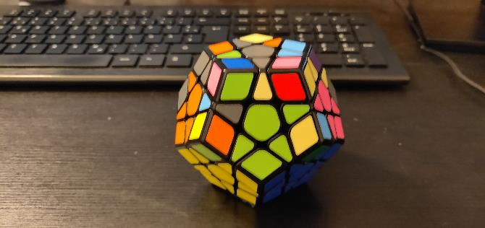
Goals
Goal 72
Moves: SP4

Slide 37
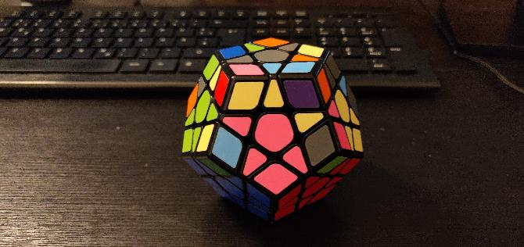
Goals
Goal 73
Moves: r_v

